Slide 1
Large Combustion Plants and their specific situation Peter VAJDA

Slide 2
What is a large combustion plant?
LCPD definition: any technical apparatus in which fuels are oxidised in order to use the heat thus generated
Fuels can be solid, liquid or gaseous
Plants for the generation of heat and electricity
50 MW rated thermal input: legislative threshold
How does a coal-fired power plant work?
coal
oil
natural gas

Slide 3
History of the LCP Directive
First European legislative instrument in this field adopted in 1988 (88/609/EEC)
Current LCP Directive adopted in 2001
In force until end 2015
From 1 January 2016, IED (Chapter III and Annex V) will take over and LCPD repealed

Slide 4
Main elements of the LCPD
Setting emission limit values for SO₂, NO_{x} and dust (particulate matter) for plants with a rated thermal input ≥ 50 MW
ELVs may vary based on the RTI and the age of the plant and on the type of fuel used (see next slide)
Different ELVs for new and existing plants (“old new”, “new new” → historical reasons)
Provisions on monitoring
Flexibility mechanisms (see later)

Slide 5
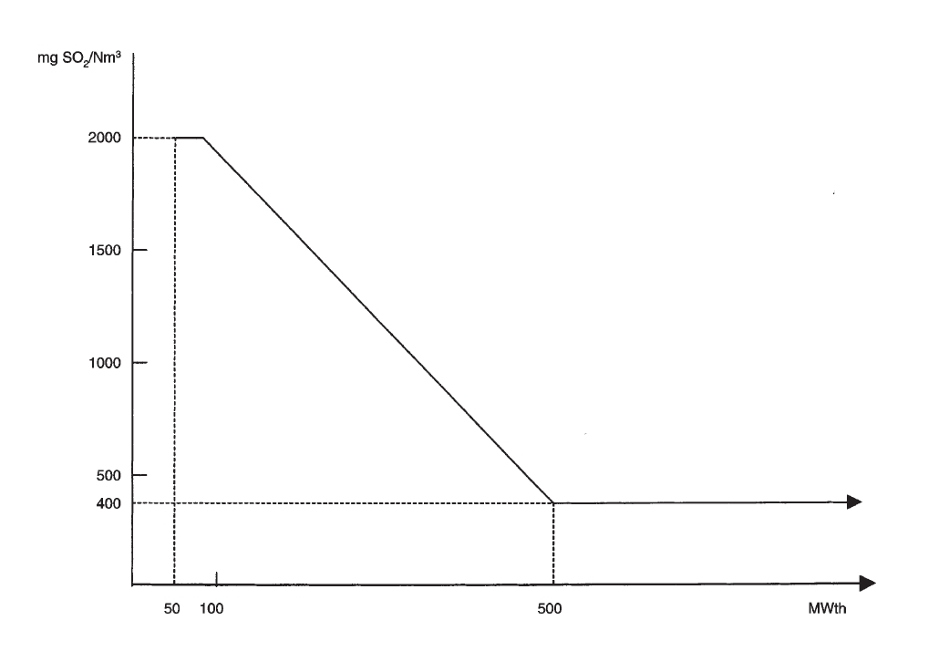
Emission limit values
SO₂, exisiting plants

Slide 6
Relationship between IPPC/IED and LCP
IPPC/IED → BAT-based permitting
LCP → emission limit values and associated monitoring
LCP should be considered as a „safety net“ for the application of BAT
BAT
LCP ELVs
non-compliance

Slide 7
Elements of flexibility
Two main ways of implementation:
1) Art. 4(1) and (2) in connection with Annexes III to VII – compliance with individual ELVs
2) Art. 4(6) - preparation of a NERP
Art. 4(4) - Limited lifetime derogation (opt-out)
Temporary exemption for meeting the ELVs
Limited in time (2008-2015) and in operational hours (20.000)
Plant has to shut down at the end of the derogation period → security of supply has to be strictly considered

Slide 8
Elements of flexibility
Art. 5(1) – Peak load plants
If a plant only operates a limited amount of hours every year, it may be subject to less stringent ELVs
Annex III, Part A – Desulphurization rate (for solid fuels)
Where the ELVs cannot be met due to characteristics of the fuel (coal with high S-content)

Slide 9
Penalties
Art. 16: “The Member States shall determine the penalties applicable to breaches of the national provisions adopted pursuant to this Directive. The penalties thus provided for shall be effective, proportionate and dissuasive.“
Alternative ways of compliance have to be considered
Main reason: non-compliance with the emission limit values, inappropriate monitoring

Slide 10
THANK YOU FOR YOUR ATTENTION!
CONTACT
peter.vajda@energy-community.org

